Slide 1

WORKOUT APP
COMP 437 TERM PROJECT BY ÖZLEM ŞERİFOĞULLARI

Slide 2
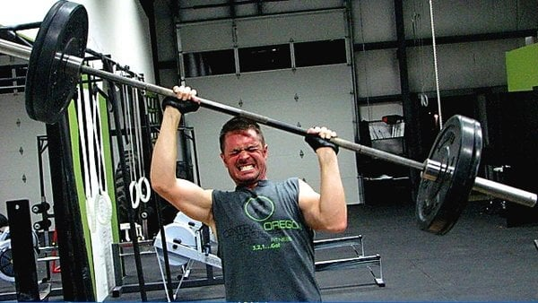

Slide 3
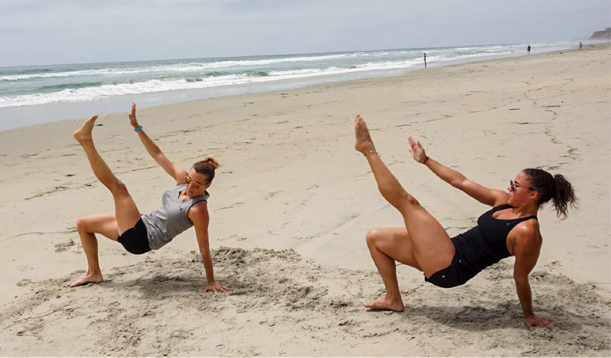
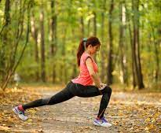
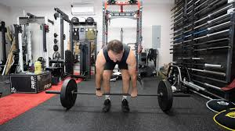

Slide 4
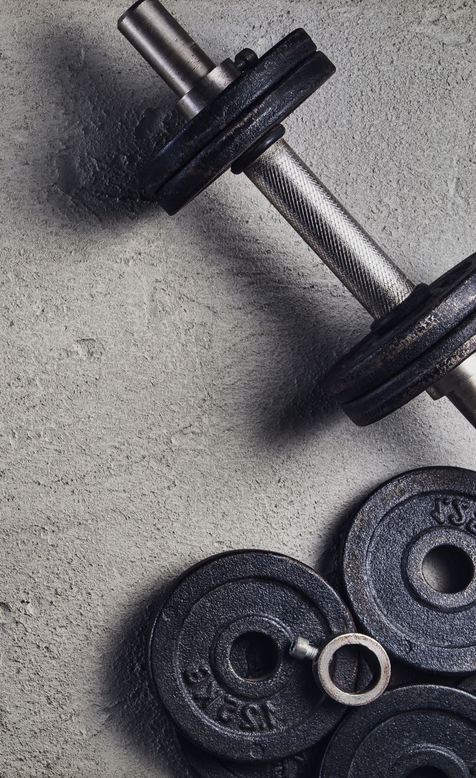
Workout app can be a need
Physical activity is important for healthy life [1], [2]
Money, time, and irregular lifestyle are barriers to workout regularly [3]
People prefer individualized workout programs [4]
Even if people overcome finacial matter and become a member of a gym, gym attendence is very low. Gym members overestimate their workout attandence by %39 margin [5]
[1] International Journal of Physical Education, Sports and Health 2016; 3(5): 22-27
[2] Janssen, I., LeBlanc, A.G. Systematic review of the health benefits of physical activity and fitness in school-aged children and youth. Int J Behav Nutr Phys Act 7, 40 (2010). https://doi.org/10.1186/1479-5868-7-40
[3] X. Chen, Z. Zhu, M. Chen and Y. Li, "Large-Scale Mobile Fitness App Usage Analysis for Smart Health," in IEEE Communications Magazine, vol. 56, no. 4, pp. 46-52, April 2018, doi: 10.1109/MCOM.2018.1700807
[4] Cadmus-Bertram LA, Gorzelitz JS, Dorn DC, Malecki KMC. Understanding the physical activity needs and interests of inactive and active rural women: a cross-sectional study of barriers, opportunities, and intervention preferences. J Behav Med. 2020 Aug;43(4):638-647. doi: 10.1007/s10865-019-00070-z. Epub 2019 Jun 13. PMID: 31197537; PMCID: PMC7891881
[5] https://doi.org/10.1016/j.psychsport.2020.101758

Slide 5
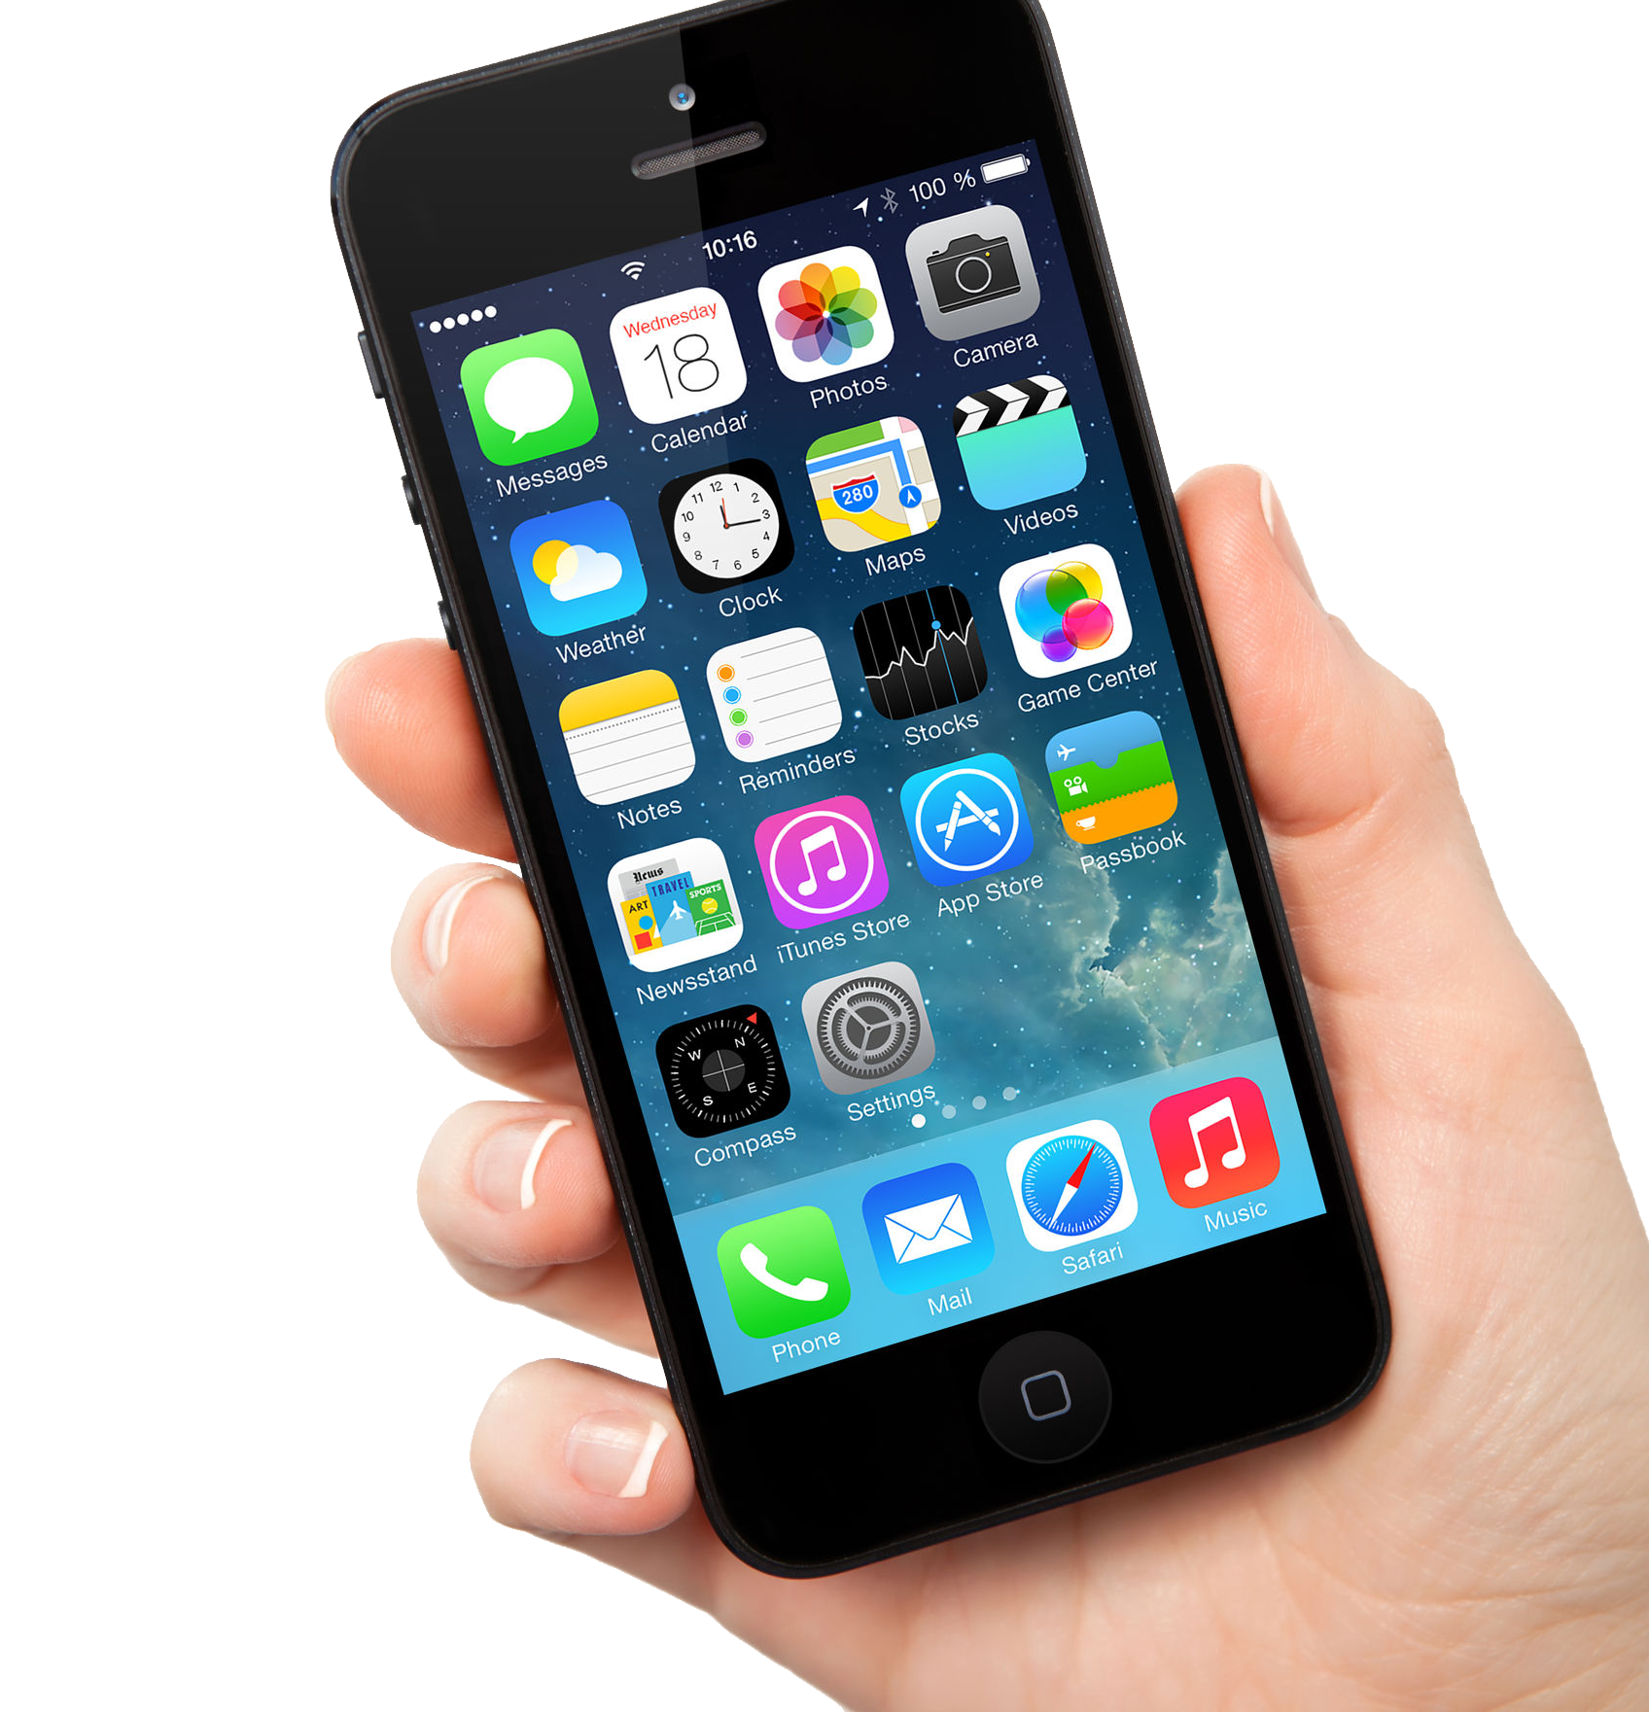
Workout app can be better
During Covid-19 lockdown in China, people prefered to use mobile apps to maintanin physical activity [7]
Gamified AR applications have great potential for enhancing user enjoyment [8]
Using AR technology can result better learning outcomes, for example mirror metaphor[9]
[7] Liu R, Menhas R, Dai J, Saqib ZA, Peng X. Fitness Apps, Live Streaming Workout Classes, and Virtual Reality Fitness for Physical Activity During the COVID-19 Lockdown: An Empirical Study. Front Public Health. 2022 Jun 22;10:852311. doi: 10.3389/fpubh.2022.852311. PMID: 35812515; PMCID: PMC9257108
[8] M. Noreikis, N. Savela, M. Kaakinen, Y. Xiao and A. Oksanen, "Effects of Gamified Augmented Reality in Public Spaces," in IEEE Access, vol. 7, pp. 148108-148118, 2019, doi: 10.1109/ACCESS.2019.2945819
[9] M. E. C. Santos, A. Chen, T. Taketomi, G. Yamamoto, J. Miyazaki and H. Kato, "Augmented Reality Learning Experiences: Survey of Prototype Design and Evaluation," in IEEE Transactions on Learning Technologies, vol. 7, no. 1, pp. 38-56, Jan.-March 2014, doi: 10.1109/TLT.2013.37
This Photo by Unknown Author is licensed under CC BY-NC

Slide 7
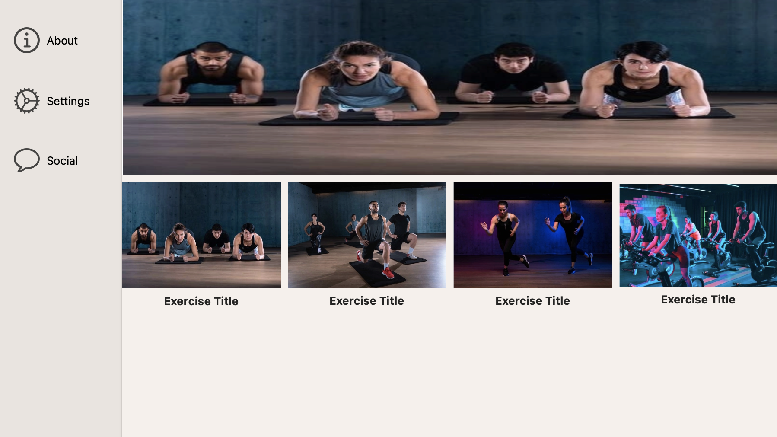
MacOS App
Writing a swift application

Slide 8

Changing Backgorund in Real-Time
Conduct a research
https://towardsdatascience.com/change-the-background-of-any-image-with-5-lines-of-code-23a0ef10ce9a
https://www.analyticsvidhya.com/blog/2021/07/learn-how-to-do-real-time-background-replacement-using-opencv-and-cvzone/
https://faun.pub/real-time-background-changing-in-python-a34511418077
https://www.banuba.com/blog/how-to-add-video-background-changer-to-your-app
OpenCV and Python
How to embed pyhton code into swift application
https://betterprogramming.pub/from-swift-import-python-f2fc2a997d4
https://medium.com/swift2go/embedding-python-interpreter-inside-a-macos-app-and-publish-to-app-store-successfully-309be9fb96a5

Slide 9

Tensorflow
Use body movements to navigate in application
Swift for Tensorflow
https://www.tensorflow.org/swift/guide/overview

Slide 10
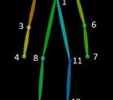
Body detection and creating skeleton
Conduct research
https://blog.xmartlabs.com/blog/computer-vision-techniques-for-body-detection/
Tensorflow pose estimation
https://www.tensorflow.org/lite/examples/pose_estimation/overview

Slide 11

Questions?

Slide 12

Thank you for listening

